Slide 1
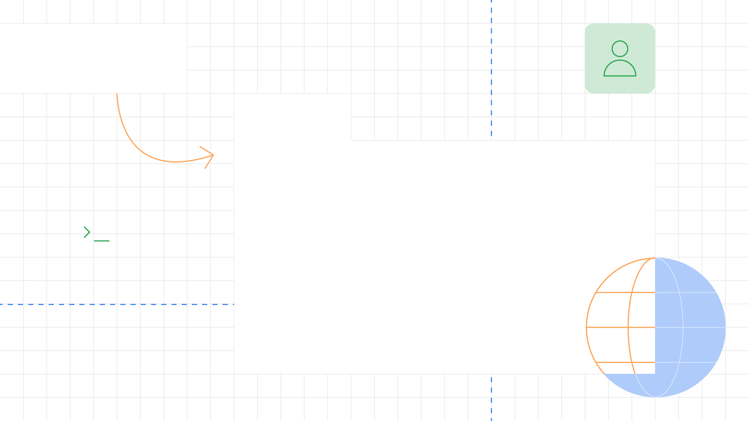



Welcome to the
Wonderful World of
Widgets
Get started using Flutter in no time.
Jay (Jeroen Meijer)
Flutter & Dart GDE
@jfkdev

Slide 2
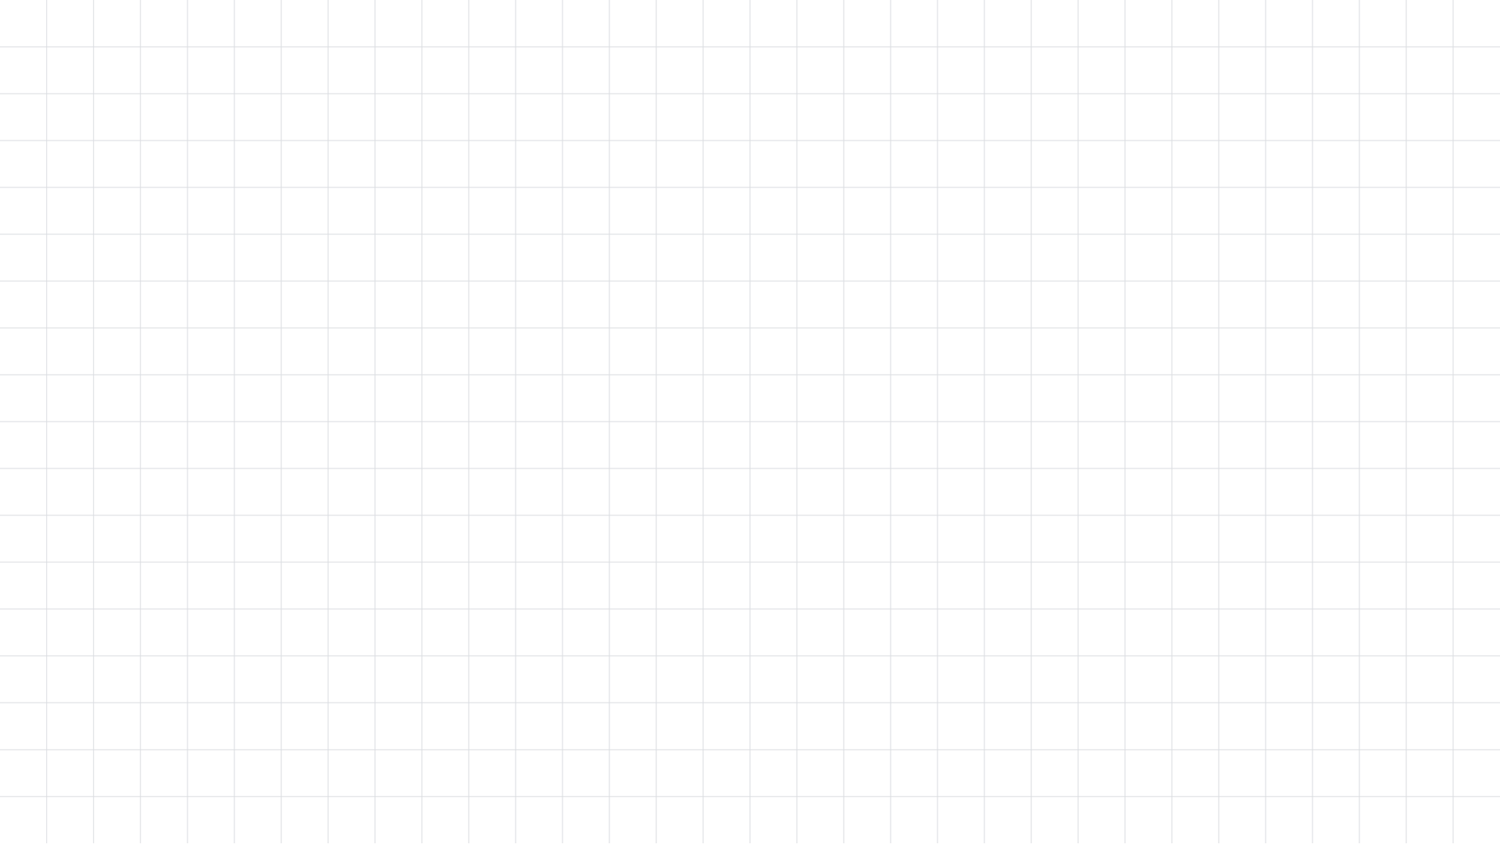

First things first
Make sure you’re ready
Keep up the pace
Installation instructions available at https://jfk.dev/install
This codelab will progress quite quickly.
Install Flutter
Install Android Studio Use a real Android device, or install an AVD/emulator
Optionally, install Visual Studio Code
You can ask questions at any time!
You can always view the slides at https://jfk.dev/talks

Slide 3


Slide 4

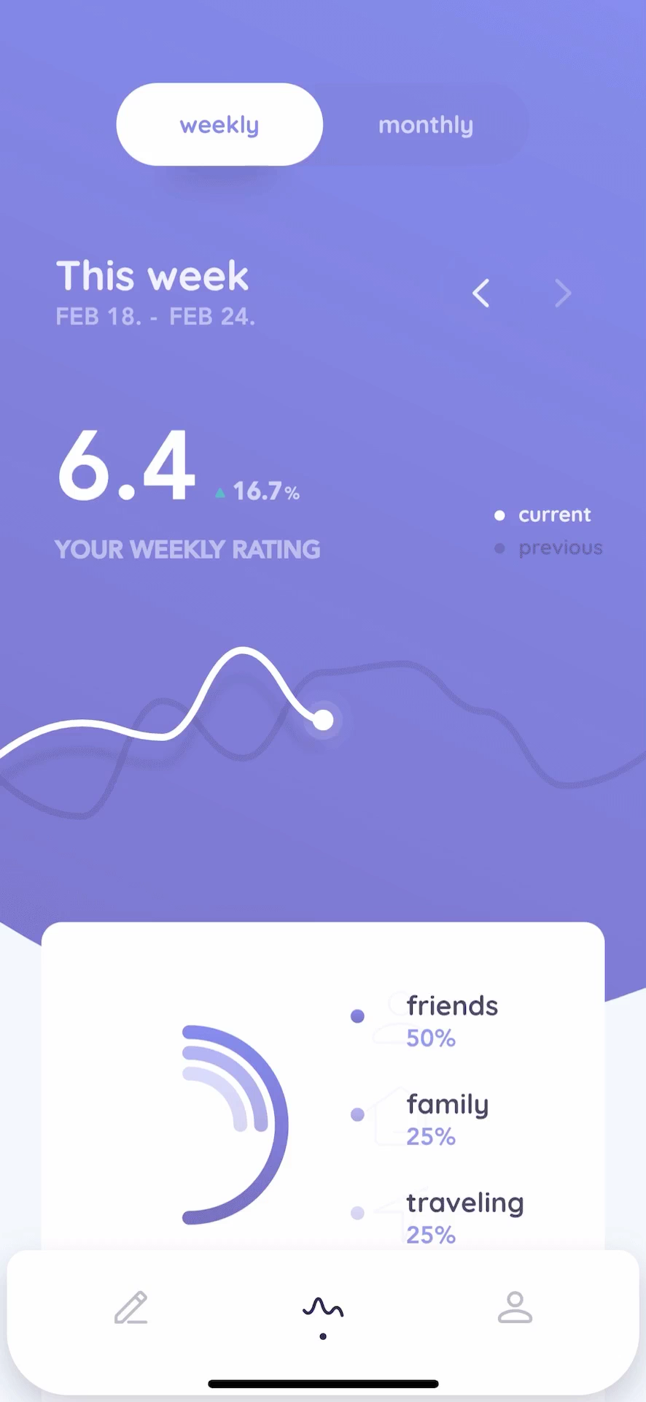
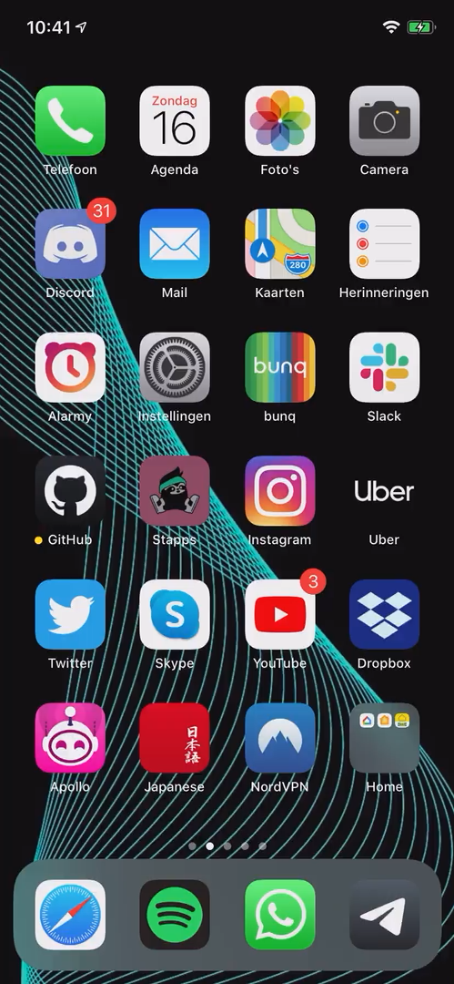
Beautiful apps in record time
reflectly
Stapps
Flutter
An open source cross-platform portable UI toolkit
Compiles to machine code
Runs natively on all platforms
Custom graphics through with the Skia rendering engine
Check https://flutter.dev/showcase

Slide 5
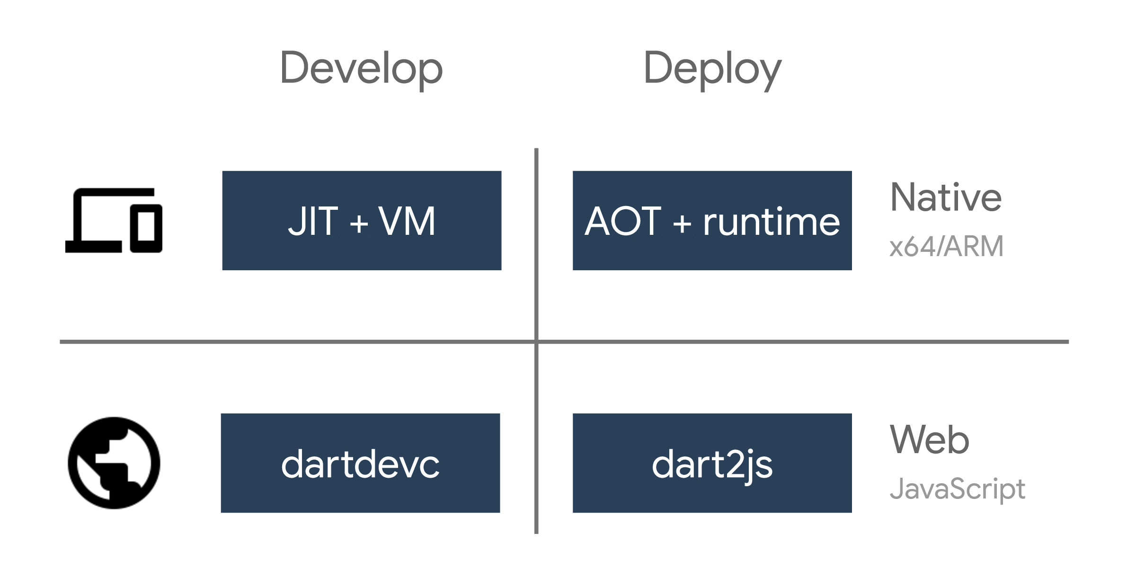
Dart
General purpose language
Familiar syntax
Compiles to multiple platforms
Allows for Hot Reload

Slide 6
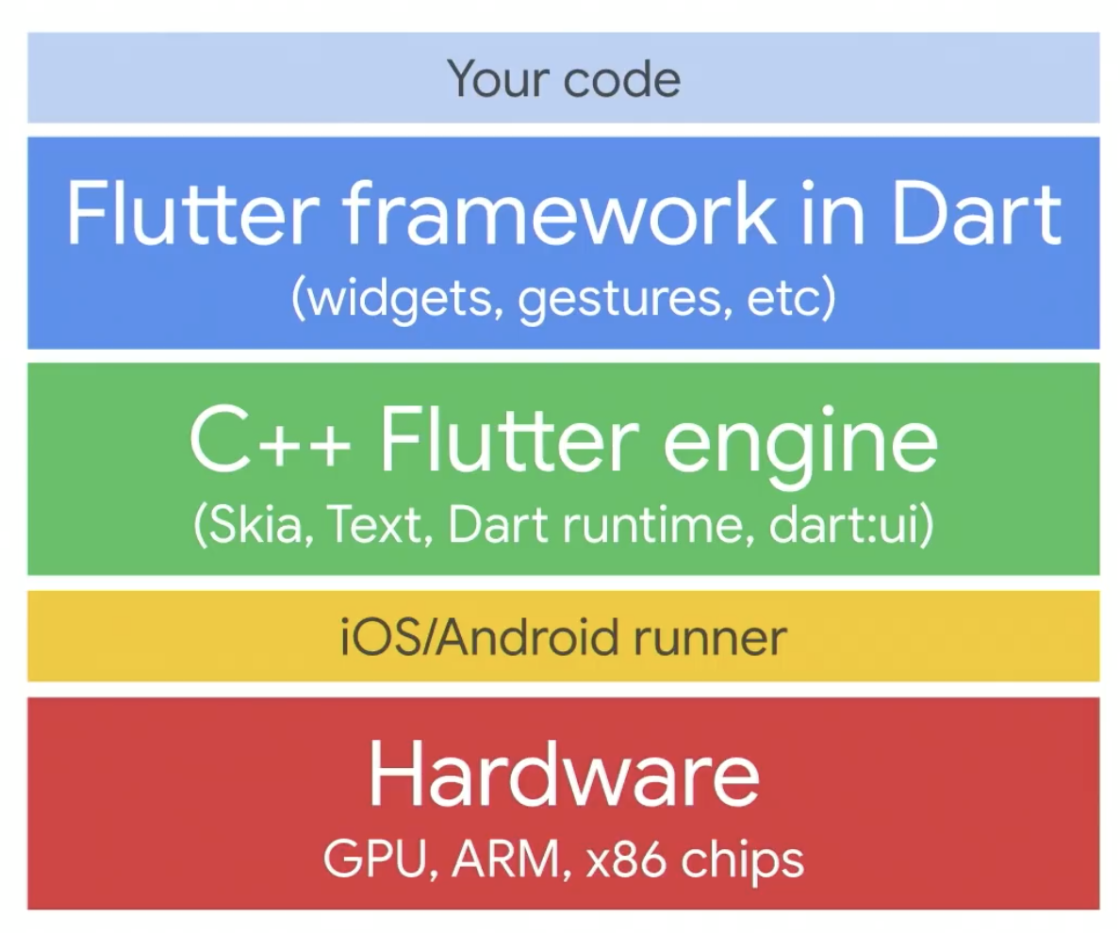
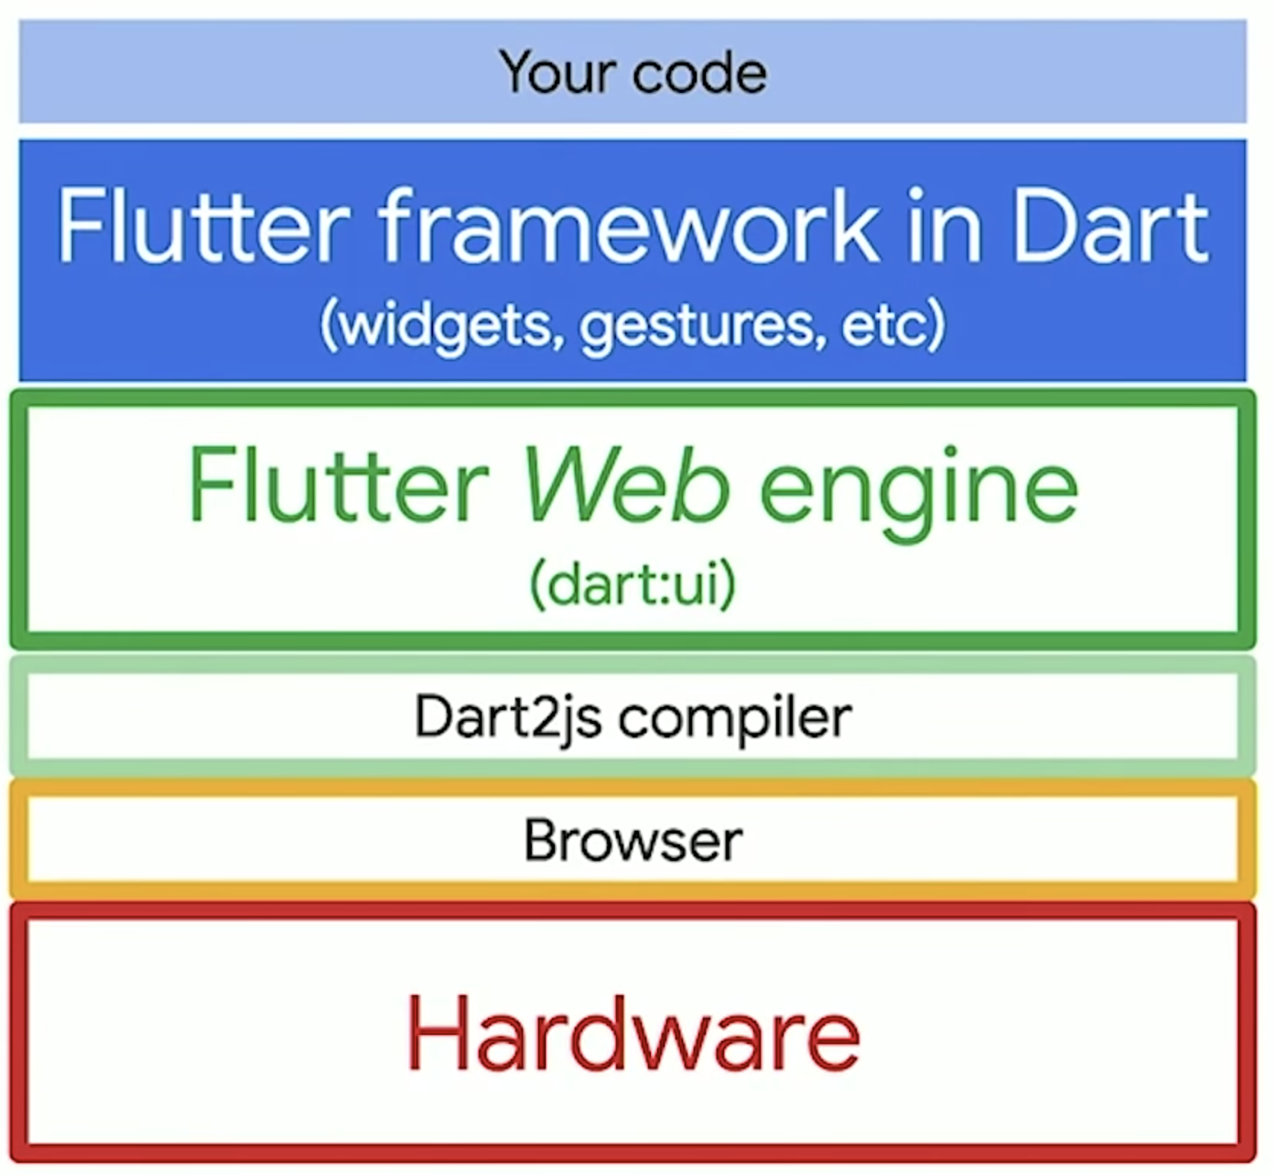
Under the Hood

Slide 7
Building UI

Slide 8
MaterialApp

Slide 9
MaterialApp
child
Scaffold

Slide 10
MaterialApp
Scaffold
AppBar
ListView
Text
"GDG Aalborg"

Slide 11
MaterialApp
Scaffold
AppBar
ListView
Text
[
ContactInfo
name: "Alice"
email: "alice@example.com"
"GDG Aalborg"
ContactInfo
name: "Bob"
email: "bob@example.com"
ContactInfo
name: "Caroline"
email: "caroline@example.com"
]

Slide 12
Let’s get coding

Slide 13
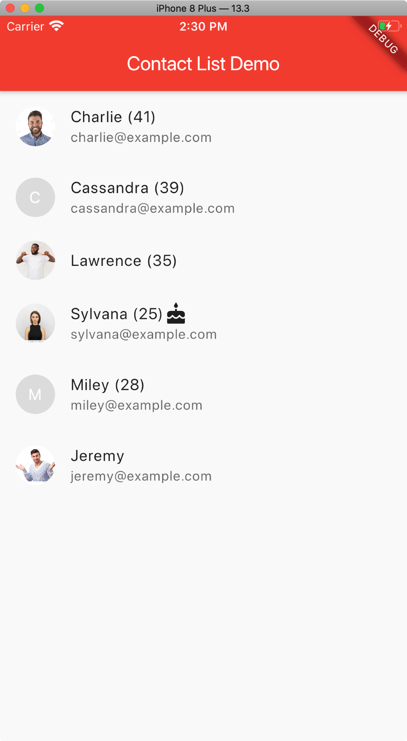
Make a project
Run flutter create contact_list
Open the project in Android Studio or Visual Studio Code.
Debug using your IDE or by running flutter run

Slide 14
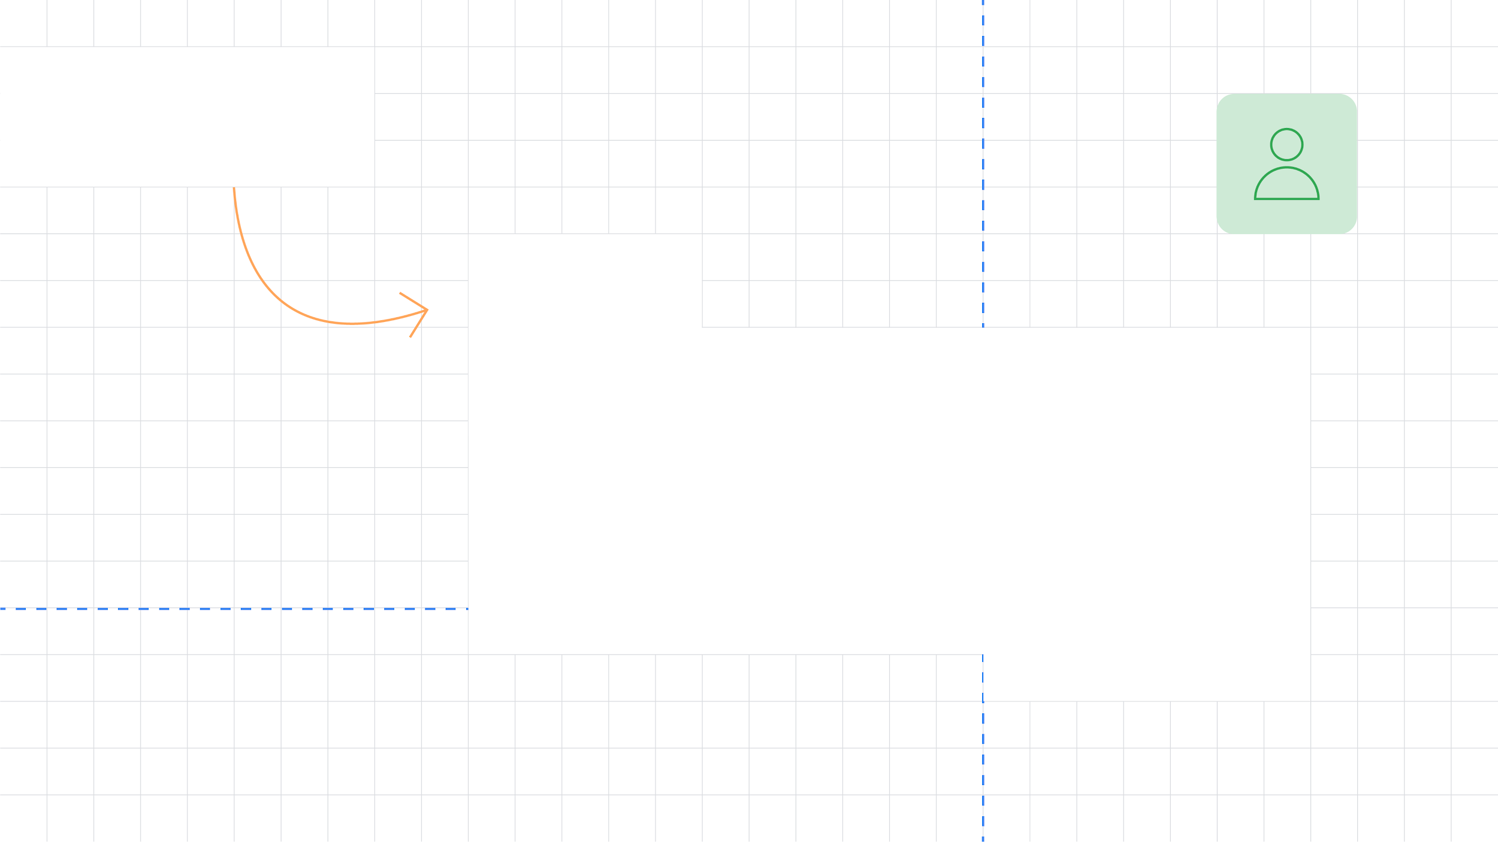
Thank You!
Slides and code available at https://jfk.dev/talks
Jay (Jeroen Meijer)
Flutter & Dart GDE
@jfkdev

